Slide 1
Lecture 10b
Network Layer (2): NAT, IPv6

Slide 2
Last Week
Internetworking
Circuit vs. message vs. packet switching
Connection oriented vs. connection less packet switching
History of Internet
Structure
Terminology
IP addressing

Slide 3
Loopback IP Address
Acts as if the packet came back to Alice’s PC when it is sent from the PC
The loopback IP address is 127.0 0.1
Think of it as a virtual network interface card
Used for testing networked applications or client-server software
Others – Run web server on local machine and access it through a browser
Loopback IP address
127.0.0.1

Slide 4
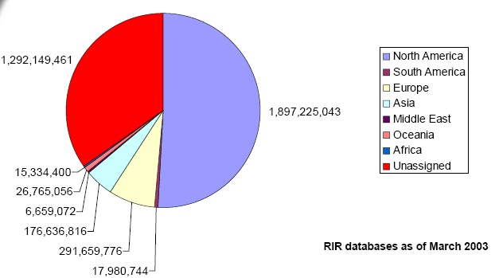
IPv4 Unicast Address Allocation
Addresses Population
China~29.4 Million 1.3 Billion
India~ 2.6 Million 1.1 Billion
Legacy Allocations
• IBM~33 Million • Genuity / BBN~51 Million
• US Government~168 Million • UK Government~33 Million
https://gsmaintelligence.com
Internet of “things”
Billions of devices?

Slide 5
Coping strategies
How to handle shortage of IPV4 addresses?
Network Address Translation (NAT)
Secondary market for IP address blocks
Purchase address blocks
E.g. Microsoft purchased 666,624 IPv4 addresses from bankrupt Nortel for $7.5 million ($11.25 per address) in April 2011
Conversion to IPv6
IPv6 accounted for “at best” 0.02% of Internet traffic on World IPv6 day (8 June 2011)
On IPv6 launch day (June 2012), Amsterdam Internet Exchange measured 0.4%

Slide 6

Non-routable Addresses
Slide modified from Agrawal
Ghost from http://www.chocwrapper.co.uk/userimages/clipart-ghost.gif
Certain IP addresses have been defined to be reusable as many times as necessary
These reused addresses will NOT be globally unique
Therefore, all routers on the Internet must know which addresses are for reuse
Defined in RFC 1918 (1996)
Used in coordination with Network Address Translation to use a small pool of IP addresses to serve a large number of computers
Does
NAT
These hosts are
invisible

Slide 7
Non-routable address blocks
Slide modified from Agrawal
Three blocks have been defined in RFC 1918
10.0.0.0 - 10.255.255.255 (10/8 prefix)
172.16.0.0 - 172.31.255.255 (172.16/12 prefix)
192.168.0.0 - 192.168.255.255 (192.168/16 prefix)
Any person or organization may use these addresses internally without any co-ordination with any Internet registry
Routers do not advertise routes with non-routable addresses to other organizations

Slide 8
NAT: Network Address Translation
Motivation: local network uses just one IP address as far as outside world is concerned:
No need to be allocated range of addresses from ISP: - just one IP address is used for all devices
Can change addresses of devices in local network without notifying outside world
Can change ISP without changing addresses of devices in local network
Devices inside local network not explicitly addressable, or visible by outside world (a security plus)
Complexity at edge router, not end devices

Slide 9
NAT Definition
Slide modified from Agrawal
NAT is specified in IETF RFC 3022
Originally envisioned as a piece of the solution to IP address shortages
Definition
Method by which IP addresses are mapped from one address block to another, providing transparent routing to end hosts
May also map ports to increase efficiency
Routinely used in large organizations, data centers and home networks
Also called NAPT (Network Address and Port Translation)

Slide 10
NAT in use
A single external IP address can support many clients in the internal network
The NAT router translates between internal non-routable IP addresses and port numbers and its own external address and port number
Directs responses to the correct internal client – using internal table with port number mapping
Designed to support outbound connections from the internal network

Slide 11
NAT Example
rest of
Internet
local network
(e.g., home network)
10.0.0/24
10.0.0.1
10.0.0.4
10.0.0.2
138.76.29.7
10.0.0.3
All packets leaving local
network have same single source NAT IP address: 138.76.29.7,
different source port numbers
Packets with source or
destination in this network
have 10.0.0/24 address for
source, destination (as usual)

Slide 12
NAT Implementation in Router
Outgoing datagrams: replace (source IP address, port #) of every outgoing datagram to (NAT IP address, new port #)
. . . remote clients/servers will respond using (NAT IP address, new port #) as destination addr.
Remember (in NAT translation table) every (source IP address, port #) to (NAT IP address, new port #) translation pair
Incoming datagrams: replace (NAT IP address, new port #) in dest fields of every incoming datagram with corresponding (source IP address, port #) stored in NAT table

Slide 13
Basic NAT operation

Slide 14
Using NAPT and RFC 1918

Slide 15
IP version 6 overview
IPv6 defined in RFC 2460
Primarily expands source and destination address fields
Also simplifies packet processing at routers
Eliminates header checksum
Modern networks assumed to be fairly robust
And adds some telecom carrier-friendly features such as flow labels

Slide 16
IP version 6 address pool
IP version 6 is mainly intended to eliminate shortage of IP addresses
Total address pool = 2¹²⁸ addresses =
340,282,366,920,938,463,463,374,607,431,768,211,456 addresses (340×10³⁶)
Surface area of earth = 510,007,200,000,000 m² (510×10¹² m²)
600 billion trillion IP addresses per square meter of the Earth’s surface (including oceans, deserts etc.)

Slide 17
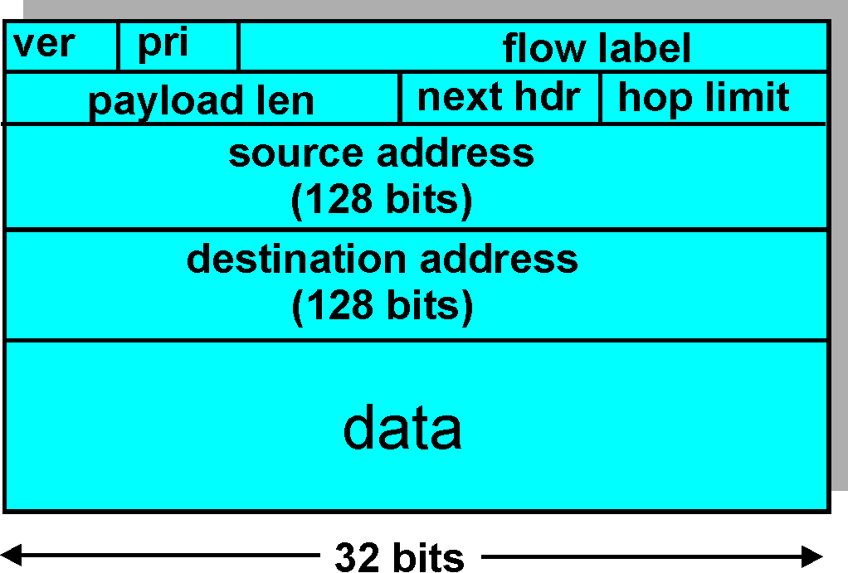
IPv6 Header

Slide 18
IP version 6 header fields
Version
6
Traffic class
Similar to IPv4 TOS field
Allows sender to specify service priority for data
Flow label
Allows sender to label a few packets for special handling

Slide 19
IP version 6 header fields
Payload length
Length of data in packet
Similar to total length field in IPv4
Next header
Transport layer user of IP
Same as protocol field in IPv4
Specified in RFC 1700
Hop limit
Same as TTL field of IPv4

